Slide 1
Lens Updates: 2D Results, Capturable Molecules, Preliminary Laser Slowing
Thursday, October 8, 2020
YbOH/CaOH Subgroup Meeting

Slide 2
Experimental Setup: Two Lenses
4K Aperture,
1 cm diameter
Beam Shutter,
1.4 cm diameter
2.54 cm
2.54 cm
1 cm³
10 cm (fixed)
Cell
Varied
Lens
Varied
Lens
Varied
31 cm (fixed)
MOT Region
26 cm (fixed)
67 cm (fixed)

Slide 3
Two-Lens Scan in 2D: CaOH
Number enhancement peaked (11x) when lenses are quite near to each other (hottest area is clustered around 20-35 cm, branches to the right and left
Consistent with previous week’s results, suggesting placement of lens ~20-35 cm from cell aperture

Slide 4
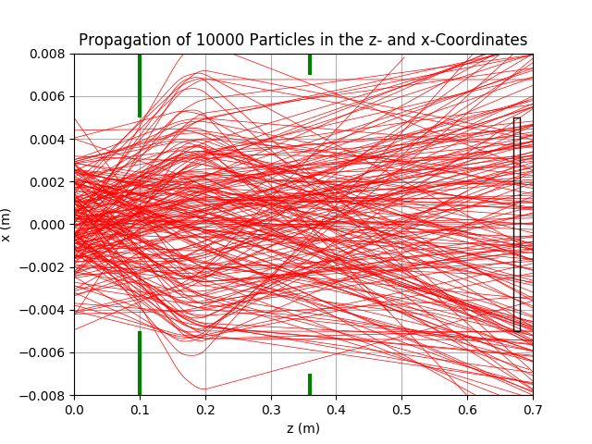
Two-Lens Scan in 2D: CaOH

Slide 5
Two-Lens Scan in 2D: CaOCH₃
Similarly, number enhancement maximized when lenses are quite near each other (hottest area is clustered around 25-35 cm)
Consistent with previous week’s results, suggesting placement of lens ~25-30 cm from the cell aperture

Slide 6
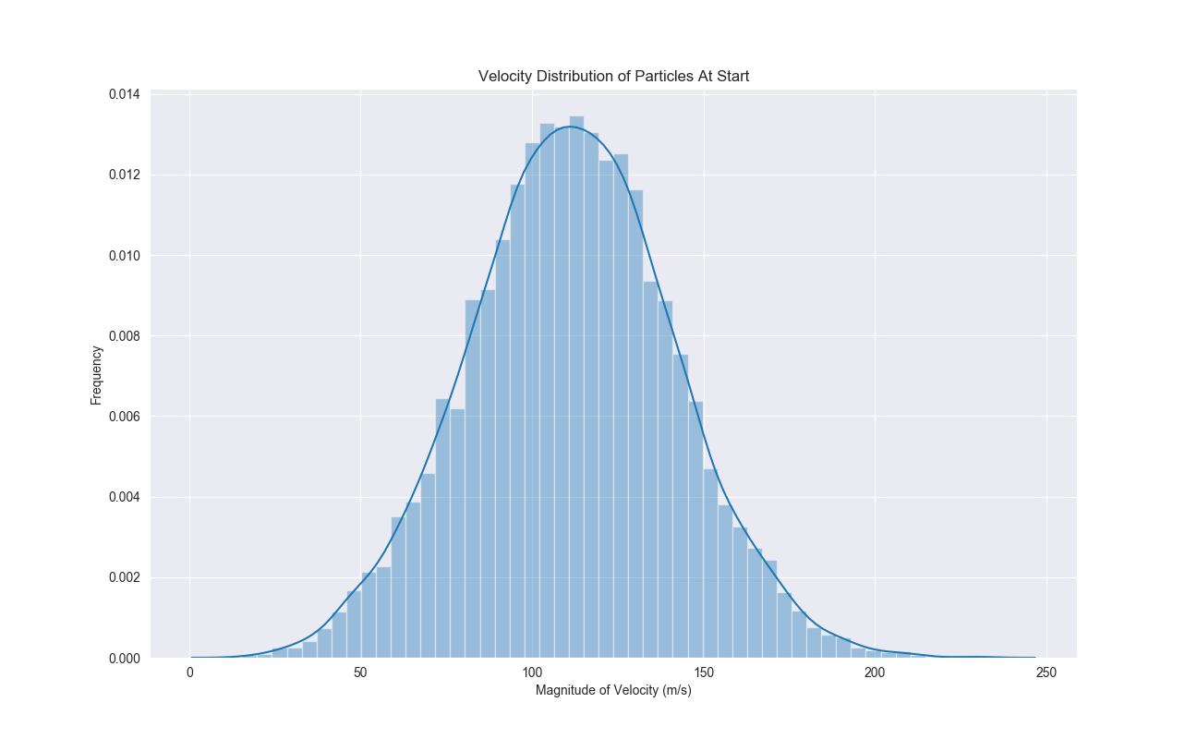
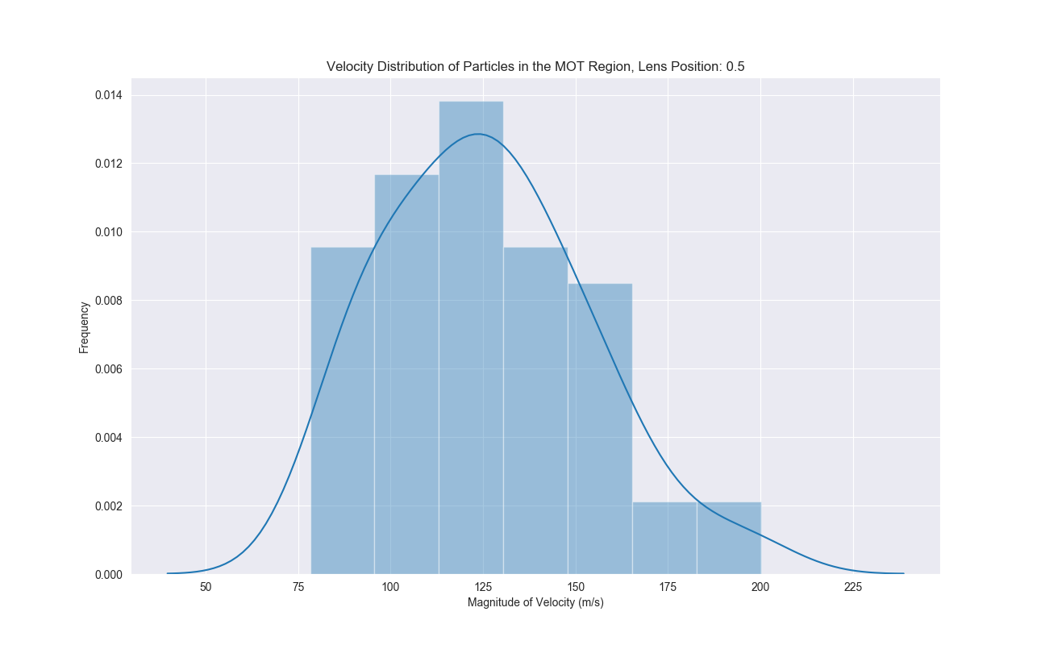
Capturable Molecules

Slide 7
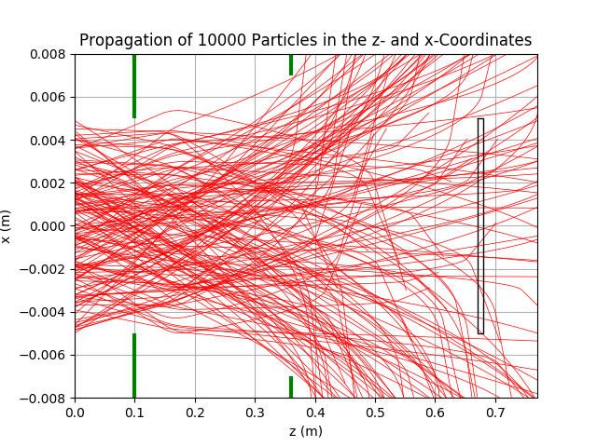
Laser Slowing
See evidence of turning inwards; the trajectories actually reverse direction in the magnet and are funneled inwards, compressing the focal length
Compared to ~0.008 without

Slide 8
Laser Slowing
Number enhancement is maximized when laser slowing with a lens placement slightly further
Assumes average deceleration: -1.1183e4 m/s^2
Enhancement ~4x at roughly 40-50 cm from the cell

